Slide 1

Überblick Microsoft Cloud Adoption Framework

Slide 2
Plan
An iterative process that supports your business … as it evolves
Govern
Manage
Define strategy
Adopt
Ready

Slide 3
Define strategy
Define strategy
Plan
Ready
Adopt
Documenting the cloud strategy will help business stakeholders and technicians understand the benefits the organization is pursuing by adopting the cloud.
Govern
Manage
Motivations
Executive mandate
DC Exit
Merger and acquisitions
Cost savings
Optimization
Agility
Tech capabilities
Market demands
Geo expansion
Migration
Innovation
Business outcomes
Fiscal: revenue, cost, profit
Agility: timer to market, provisioning,
Reach: global access, sovereignty
Customer engagement: cycle time, from request to release
Performance: SLAs, Downtime, operations, reliability
Business justification
Business case: the cloud is not always cheaper, mirroring is not cloud, servers drive cost analysis
Financial model: Capex/ Opex, ROI, gain, cost avoidance/reduction
Cloud accounting: cost center, procurement, profit center, revenue generating, chargeback
First project
Business criteria: workload supported by a BDM
Technical criteria: minimum dependencies and test path, no governance
Qualitative analysis: Current Team analysis

Slide 4
Plan
Define strategy
Plan
Ready
Adopt
Cloud adoption plans convert the aspirational goals of the cloud adoption strategy into actions. It will help guide technical efforts, in alignment with the business strategy.
Govern
Manage
Digital estate
Rationalization: inventory
Quantitative analysis: asset optimized and sized properly
Qualitative analysis: operational process
Initial organization alignment
Cloud Strategy Team
Business IT: requirements and needs
IT management operations: traditional IT
Governance: executive sponsor, finance, business leadership, legal, security, HR
Cloud platform vendor: account success team
Cost management
IT-business alignment
Governance MVP
Skill readiness plan
Organizational readiness
Governance and security alignment
Initial organization alignment
Building technical skills: business/technical, and certifications
Change management guidance
Cloud adoption plan
5R strategy: rehost, refactor, rearchitect, rebuild, replace
Infrastructure migration: VM, server, database focus
Application innovation: born in the cloud applications, APIs
Data-driven innovation: Focus on data consolidation and analysis

Slide 5
Ready
Define strategy
Plan
Ready
Adopt
Ready establishes a cloud foundation or Adoption Target that can provide hosting for any adoption efforts. This should consist of common denominators across 80–90% of cloud adoption.
Govern
Manage
Azure readiness guide
Resource management: management groups, subscriptions, resource groups, resources tree hierarchy
Naming Standards
Resource tags
Landing zone infrastructure
Network design: Vnet, hybrid, firewall, hub, front door, endpoints
Storage design: disk, file, blobs, CDN
Compute design: VMs, containers, apps, serverless
Data design: Structured/ unstructured
Landing zone ID
Identity and access
Role-based access control RBAC
Manage to least privilege
Landing zone cost
Costs and billing
Analyze Cloud Costs
Monitor with budgets
Optimize with recommendations
Manage invoices and payments
Blueprints
AI
BigData
Hybrid networks
Identity management
IoT
Serverless
SAP
VMs
WebApps
DevOps

Slide 6
Adopt: Migrate
Define strategy
Plan
Ready
Adopt
Cloud adoption will include workloads which do not warrant significant investments in the creation of new business logic. These workloads are candidates for migration to the cloud.
Govern
Manage
Assess
Evaluate assets and establish a plan
Validate pre-requisites: landing zone, skilling
Drivers: reducing capex, freeing up DC
Quantitative factors: VMs, networking, compatibility
Qualitative factors: process dependencies, critical business events
Migrate: rehost
Replicate (lift and shift) on-prem functionality using cloud native technology
Leverage Azure Migration Guide
Optimize
Balance performance and price
Deliver the right experience within budget
Resize VM size, resize storage, resize database
Secure and manage
Prepare the migrated asset for ongoing operations: security, monitoring, configuration

Slide 7
Adopt: Innovate
Define strategy
Plan
Ready
Adopt
Older apps can take advantage of many of the same cloud-native benefits by modernizing the solution or components of the solution. Modern DevOps invites into the process to create shorter feedback loops and better customer experiences.
Govern
Manage
Infrastructure abstraction
Cloud native applications built from the ground up optimized for cloud:
Resiliency
Global scale
Agility
Security
Autoscaling
Innovate: refactor
Refactoring an application to fit a PaaS/Serverless-based model or refactoring code to deliver on new business opportunities.
Drivers: faster and shorter updates, code portability, greater cloud efficiency (resources, speed, cost)
Innovate: rearchitect
Modify existing applications into managed containers to take advantage of cloud native benefits
Drivers: application scale and agility, easier adoption of new cloud capabilities, mix of technology stacks
Innovate: rebuild
A new code base is created to align with a cloud-native approach. App Data and AI Services
Drivers: accelerate innovation, build apps faster, reduce operational cost
DevOps
Culture
Development
Testing
Release
Monitoring
Management

Slide 8
Govern
Define strategy
Plan
Ready
Adopt
Adopting the cloud is a journey, not a destination. Along the way, there are clear milestones and tangible business benefits. The final state of cloud adoption is unknown when a company begins the journey. Cloud governance creates guardrails that keep the company on a safe path throughout the journey.
Govern
Manage
Establish your methodology:
Establish a basic understanding of the methodology that drives cloud governance in the Cloud Adoption Framework to begin thinking through the end state solution.
Use the governance benchmark tool:
Assess your current state and future state to establish a vision for applying the framework.
Establish an initial governance foundation:
Begin your governance journey with a small, easily implemented set of governance tools. This initial governance foundation is called a minimum viable product (MVP).
Improve your initial governance foundation:
Throughout implementation of the cloud adoption plan, iteratively add governance controls to address tangible risks as you progress toward the end state.

Slide 9
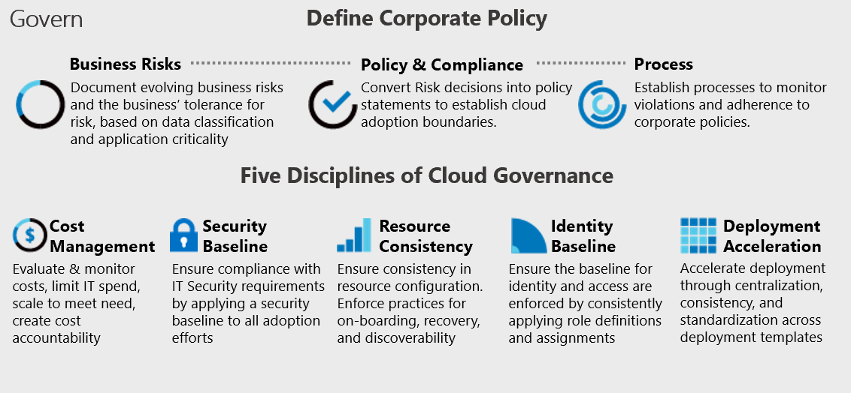
Cloud Adoption Framework’s Govern methodology

Slide 10
Manage and operations
Define strategy
Plan
Ready
Adopt
Manage and operations enumerates, implements, and iteratively reviews related to the expected operational behavior of the service.
Govern
Manage
Define business commitments
Document supported workloads to establish operational commitments with the business and agree on cloud management investments for each workload.
Establish a management baseline:
Define the criticality classifications, cloud management tools, and processes required to deliver your minimum commitment to operations management.
Expand the management baseline:
Based on business commitments and operations decisions, make use of the included best practices to implement the required cloud management tooling.
Advanced operations and design principles:
Platforms or workloads that require a higher level of business commitment might require a deeper architecture review to deliver on resiliency and reliability commitments.

Slide 11
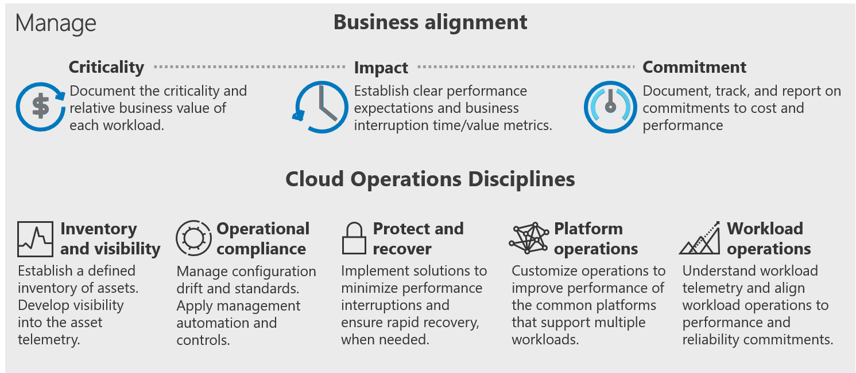
Cloud Adoption Framework's Manage methodology

Slide 12
Microsoft Cloud Adoption Framework for Azure
Adopt
Define Strategy
Understand motivations
Business outcomes
Business justification
Prioritize project
Plan
Digital estate
Initial organization alignment
Skills readiness plan
Cloud adoption plan
Ready
Azure readiness guide
First landing zone
Expand the blueprint
Best practice Validation
Migrate
• First workload migration
• Expanded scenarios
• Best practice validation
• Process improvements
Innovate
• Innovation guide
• Expanded scenarios
• Best practice validation
• Process improvements
Govern
Methodology • Benchmark
initial best practice • Governance maturity
Manage
Business commitments
operations baseline • Ops maturity

Slide 13
Microsoft Cloud Adoption Framework for Azure
Security is a discipline you practice along your entire cloud adoption path
Define strategy
Define motivations, and create a business case leveraging cloud economics
Plan
Create actionable cloud adoption plan aligned to the strategy
Ready
Prepare cloud environments with Azure landing zones
Adopt
Migrate or Innovate
Design, build and deploy workloads to Azure
Ready
Prepare cloud environments with Azure landing zones
Security is a critical design area here
Govern
Automate governance baseline and empower delegated responsibility
Govern
Automate governance baseline and empower delegated responsibility
Manage
Build operations baseline and support enterprise operations
Manage
Build operations baseline and support enterprise operations
Secure
Establish security baseline and manage security posture
Security is a discipline of governance & automated guardrails
Security drives your operations baseline implementation
All of which depend on sound security posture management

Slide 14


Cloud Adoption Framework – Secure methodology End state for managing your overall security posture
Business alignment
Business alignment
Establish cross-org processes to scale cloud security throughout your business
Secure
Risk insights
Integrate security insights into risk management framework and digital initiatives.
Security integration
Integrate security insights and practices into business and IT processes
Operational resilience
Ensure organization can operate during attacks and rapidly regain full operational status.
Security disciplines
Security disciplines
Implement proven security processes built on modern, cloud-based security tools
Access control
Establish Zero Trust access model. Extend modern protection to legacy assets.
Security operations
Detect, respond, and recover from attacks; hunt for hidden threats; lead through data-driven decision
Asset protection
Protect sensitive data and systems. Continuously discover, classify & secure assets.
Security governance
Continuously identify, measure, and manage security posture to correct deviation and reduce risk.
Innovation security
Integrate security into DevSecOps processes. Align security, development, and operations practices.
Cloud security team
Establish team with expertise and experience for security and cloud. Often a cross-functional security team(s) that includes members of security team, cloud center of excellence (CCoE), Cloud operations, IT operations, and others.

